Slide 1
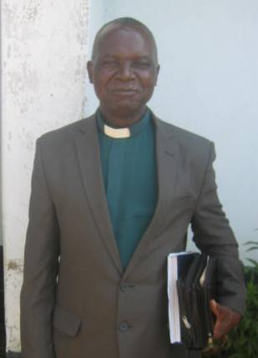
Rev A G Mhururu was born on 13 March 1956 in Zaka, Masvingo.
He is a proud father of four children and three grandchildren.
Rev A G Mhururu is one of the most senior ministers of religion in the United Church of Christ in Zimbabwe.
He has a strong belief in contextual development.
He is the current pastor of UCCZ Glen View

Slide 2
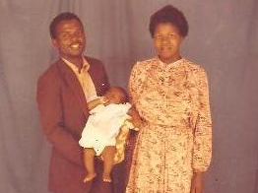
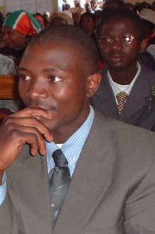
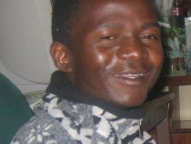
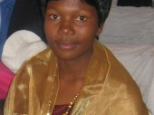

Slide 3
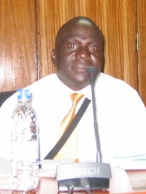
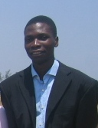
Owen Dhliwayo, married to Rejoice
Fred Gadaga married to Tariro

Slide 4
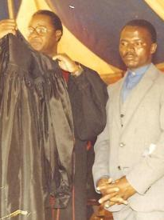
Rev A G Mhururu became a minister of religion in the United Church of Christ in Zimbabwe on the 1st of January 1982.
He was subsequently ordained on 29 June 1986 at Highfield Church in Harare.
Since then he has served the Church in different capacities including a Conference Minister, Volunteers Council President and regional ministers’ retreat chairperson.

Slide 5
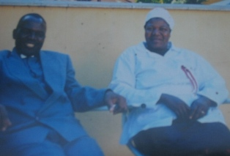
Rev A G Mhururu and Monica Mhururu were married for 27years and were blessed with four children. Sadly Monica Mhururu passed away on 12 February 2007, five months before their first daughter – Rejoice was to wed Owen Dhliwayo.

Slide 6
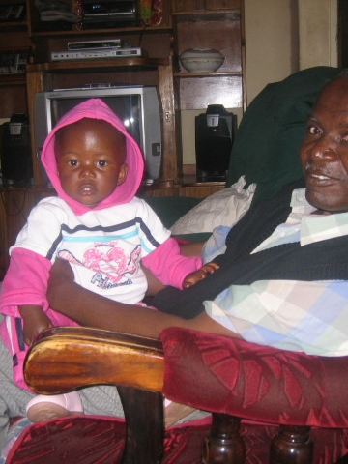
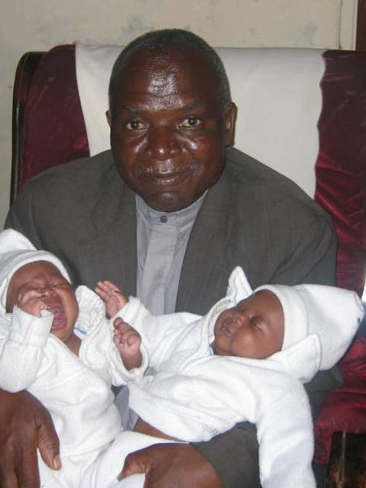
With Dionne Shannel Dhliwayo
Born: 05 April 2009
Anisha and Alisha Gadaga
Born: 13 August 2011

Slide 7
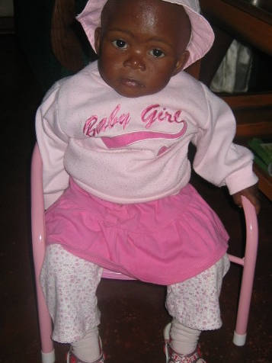
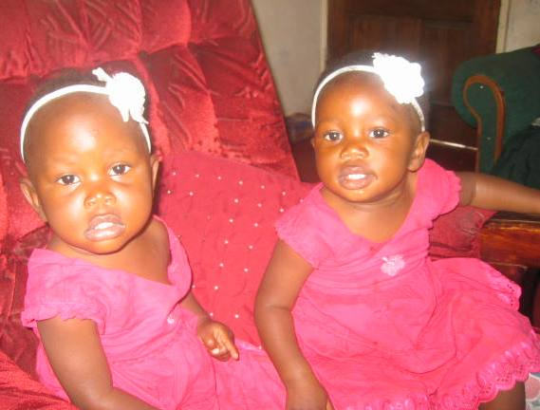

Slide 8
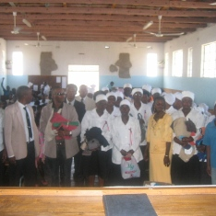
At Glen View Church, he has managed to ensure the drilling of a borehole – a development that is assisting the Glen View community with provision of a clean and reliable water source.

Slide 9
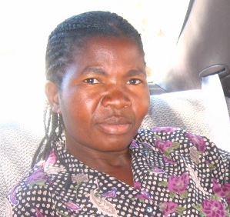
On 28 April 2013, Rev A G Mhururu will walk down the aisle to be joined in Holy Matrimony with Ms Gamuchirai Taremba

Slide 10
He is a father, pastor, leader, advisor and above all Christian who believes in equal opportunities for all members of the society.

